Slide 1



Magellanic System Stars Identified in the SMACS J0723-73 JWST ERO Images
Jake Summers
Mentors: Dr. Rogier Windhorst & Dr. Seth Cohen
School of Earth and Space Exploration, ASU
AZSGC Symposium, ASU
April 22, 2023

Slide 2
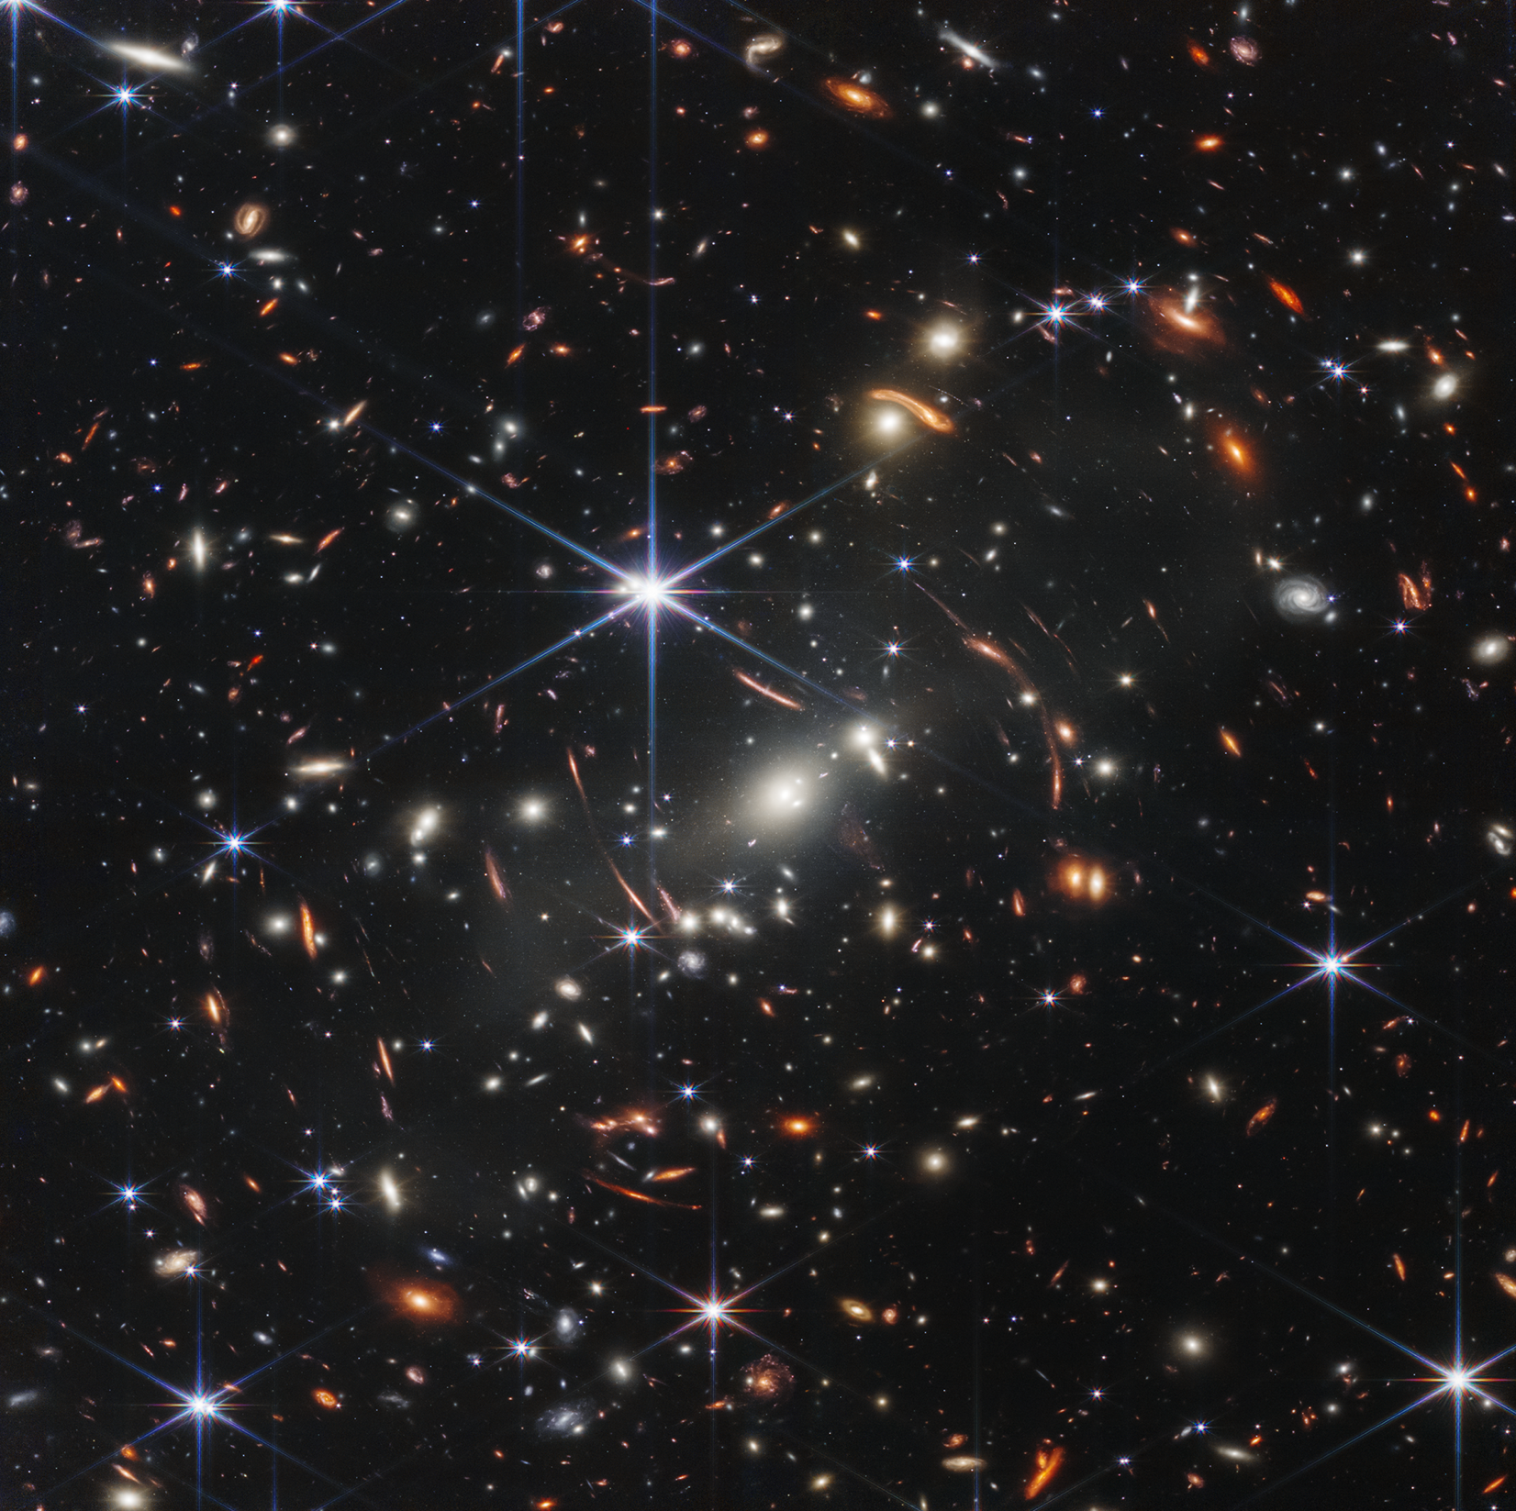
Background – SMACS J0723-73
Part of the Southern Massive Cluster Survey
First JWST image released on July 11, 2022
Image credit: https://webbtelescope.org/

Slide 3
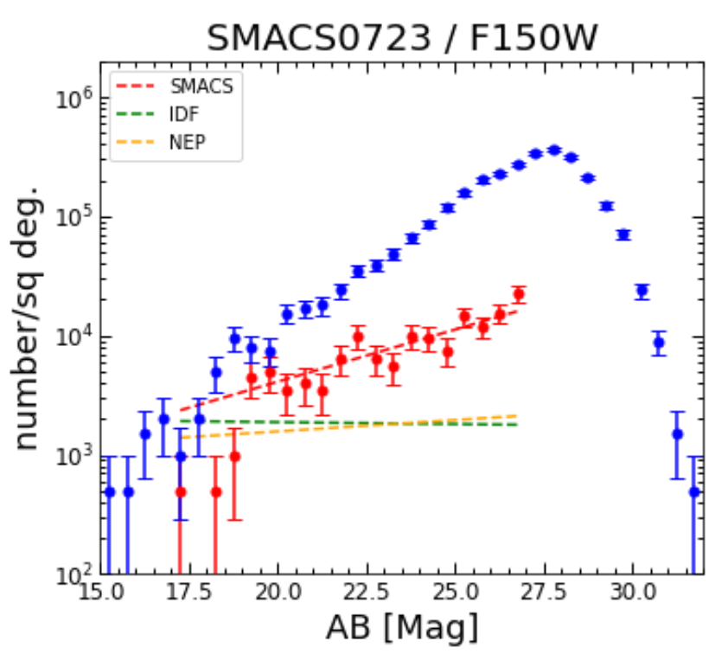
Star Excess
Star counts in SMACS0723 slope upward
Other fields have flat star counts
Too many faint stars

Slide 4
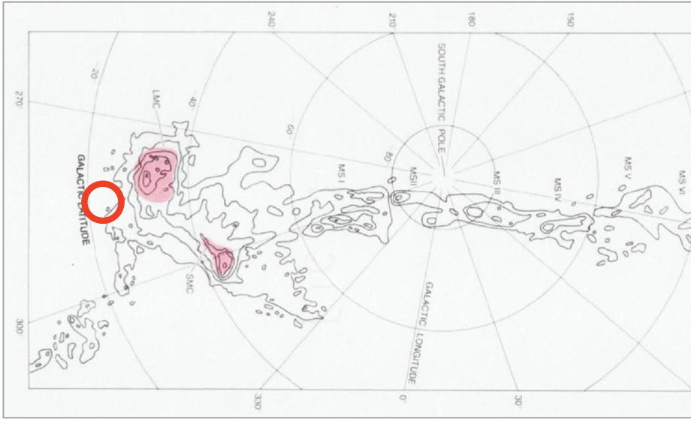
Large Magellanic Cloud
LMC – dwarf satellite galaxy to the Milky Way
SMACS0723 is only ~10 deg. away
SMACS0723
Image credit: Mathewson 2012 – “Discovery of the Magellanic Stream”

Slide 5
Data –
SMACS0723
6 filters – 0.9-4.4 microns (near-IR)
7537 s (2.09 hrs) in each filter – 12.5 hrs total!
Cluster and noncluster module

Slide 6
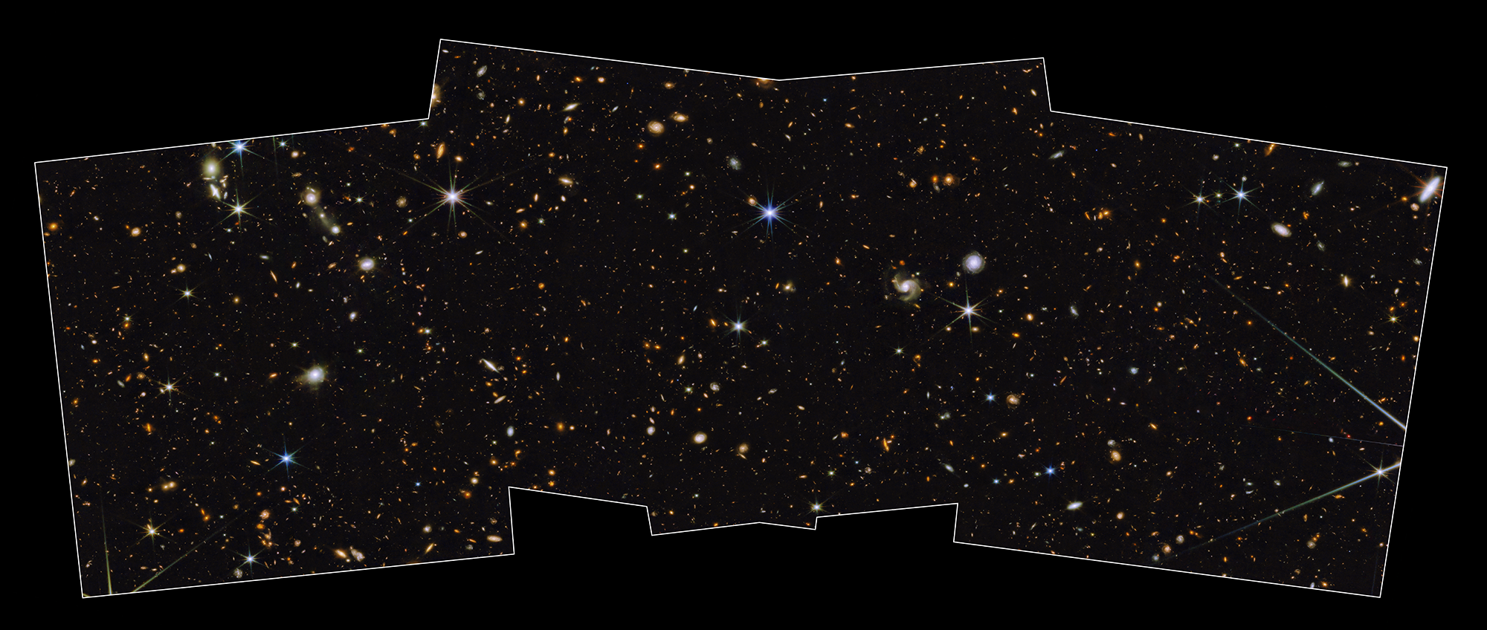
Data – North Ecliptic Pole Time Domain Field
Medium-deep blank field with two “spokes” – covers a large area
8 filters – 0.9-4.4 microns (~3000 s each)
Prime Extragalactic Areas for Reionization and Lensing Science (PEARLS) survey (https://sites.google.com/view/jwstpearls)
Image credit:
https://webbtelescope.org/

Slide 7
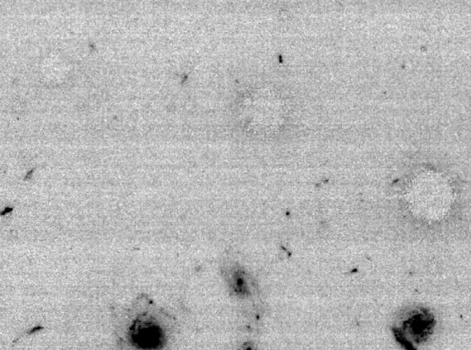
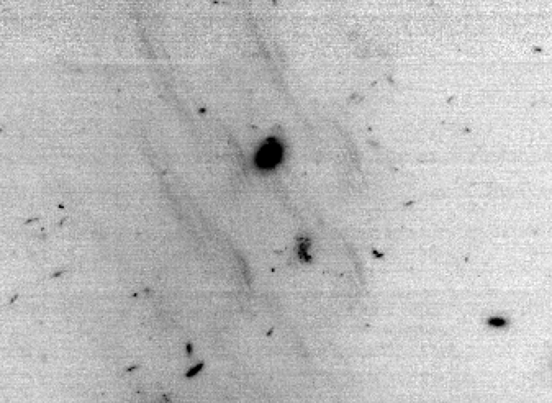
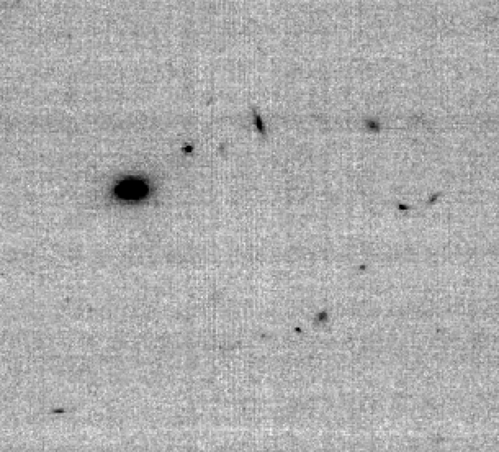
Methods – Data Reduction
Snowballs
JWST Calibration Pipeline
1) Stage 1 – Detector level corrections
2) Snowball subtraction
3) Stage 2 – Instrument level calibrations
4) Wisp subtraction
5) Sky and 1/f noise subtraction
6) Stage 3 – “Drizzle” individual exposures into one image (“mosaic”) for each filter
Wisps
1/f noise (striping)

Slide 8
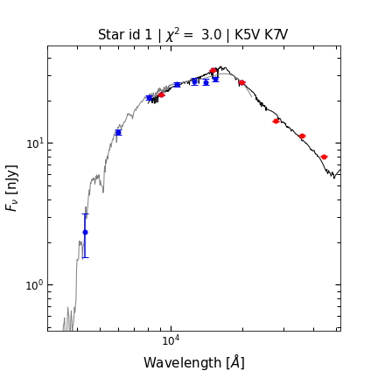
Methods – Source Detection & SED Fitting
Source detection done using SourceExtractor
Fit SEDs with EAZY (Easy and Accurate Zphot from Yale) algorithm
Used spectra of main sequence stars as templates for EAZY
Calculated the probability distribution of each star’s distance modulus (m-M) using Bayesian statistics

Slide 9
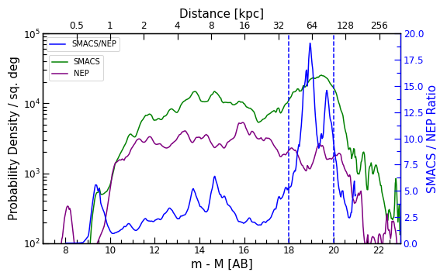
Results
Peak between 40 and 100 kpc in SMACS0723
No peak in NEP TDF
LMC distance = 50 kpc
~3.8 sigma difference between 40 and 100 kpc

Slide 10
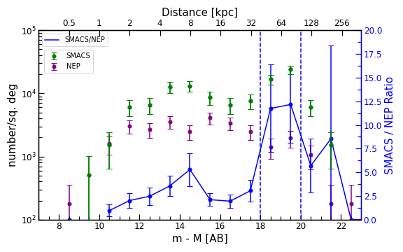
Results
Peak also shows up in discrete star counts

Slide 11
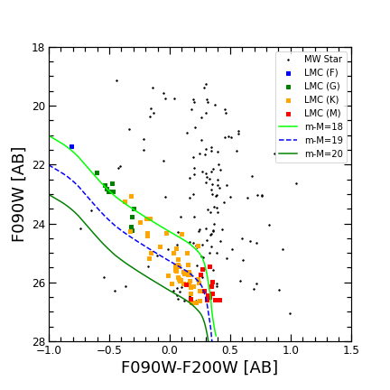
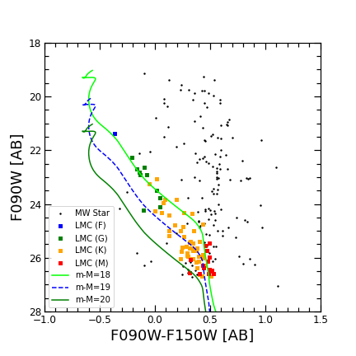
Color-Magnitude Diagrams

Slide 12
Conclusion
75 stars identified between 40 and 100 kpc in SMACS0723
Metallicity similar the to LMC ([Fe/H]=-0.4)
Could be a stellar component to the Magellanic Leading Arm or a stellar halo of the LMC

Slide 13
Acknowledgements
Dr. Rogier Windhorst
Dr. Seth Cohen, Dr. Rolf Jansen, Dr. Timothy Carleton, Dr. Patrick Kamieneski
The rest of the PEARLS team
ASU/NASA Space Grant

Slide 14
Thank You!
jssumme1@asu.edu

